Slide 1

== SQL == (Structured Query Language)
Jakarta, 21 Maret 2018
MFM (MELEK FOR MEMBER)
DATA SCIENCE INDONESIA
2018

Slide 2
Outline
INTRODUCTION
SQL BASIC
SQL INTERMEDIATE
SQL ADVANCE

Slide 3
INTRODUCTION

Slide 4
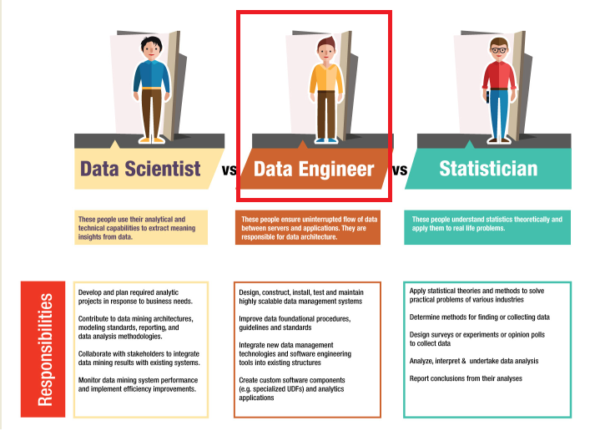
INTRODUCTION
Comparison
Jobs in Data Science
Relational Database
What is SQL ?

Slide 5
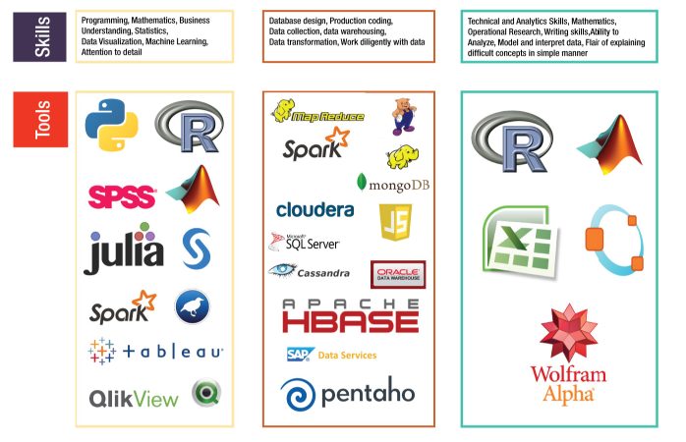
INTRODUCTION
Comparison
Jobs in Data Science
Relational Database
What is SQL ?

Slide 6
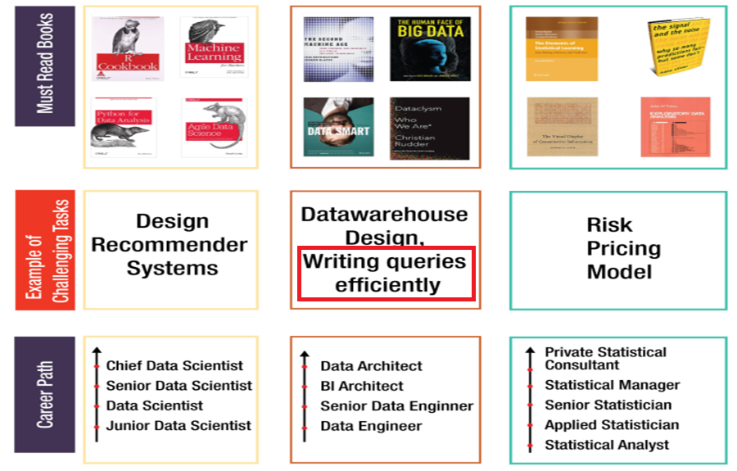
INTRODUCTION
Comparison
Jobs in Data Science
Relational Database
What is SQL ?

Slide 7
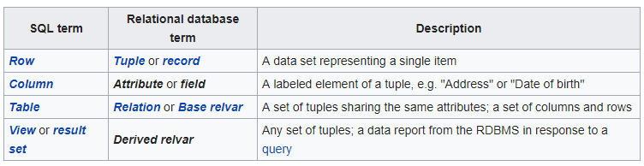
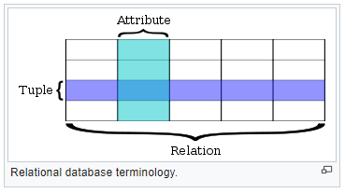
INTRODUCTION
Comparison
Jobs in Data Science
Relational Database
What is SQL ?
The relational database was first defined in June 1970 by Edgar Codd, of IBM's San Jose Research Laboratory. A relational database has become the predominant type of database. Other models besides the relational model include the hierarchical database model and the network model.
The table below summarizes some of the most important relational database terms and the corresponding SQL term:

Slide 8
INTRODUCTION
Comparison
Jobs in Data Science
Relational Database
What is SQL ?
Keys
Consists of one or more attributes that determine other attributes
Primary key (PK) is an attribute (or a combination of attributes) that uniquely identifies any given entity (row)
Key’s role is based on determination
If you know the value of attribute A, you can look up (determine) the value of attribute B

Slide 9
INTRODUCTION
Comparison
Jobs in Data Science
Relational Database
What is SQL ?
Keys (continued)
Controlled redundancy:
Makes the relational database work
Tables within the database share common attributes that enable the tables to be linked together
Multiple occurrences of values in a table are not redundant when they are required to make the relationship work

Slide 10
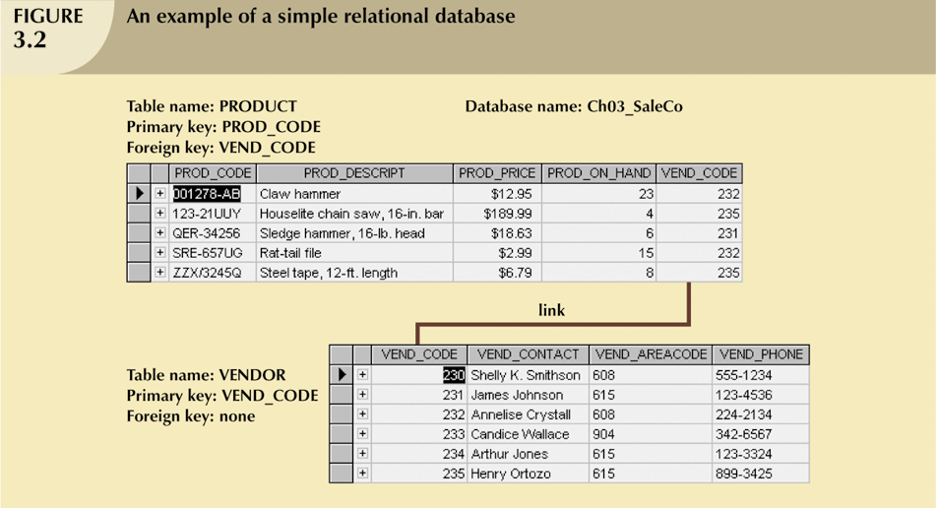
INTRODUCTION
Comparison
Jobs in Data Science
Relational Database
What is SQL ?
Keys (continued)

Slide 11
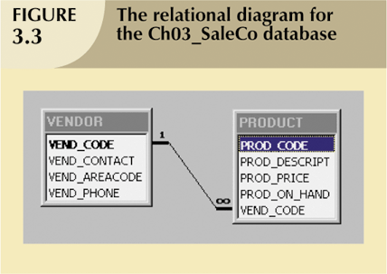
INTRODUCTION
Comparison
Jobs in Data Science
Relational Database
What is SQL ?
Keys (continued)

Slide 12
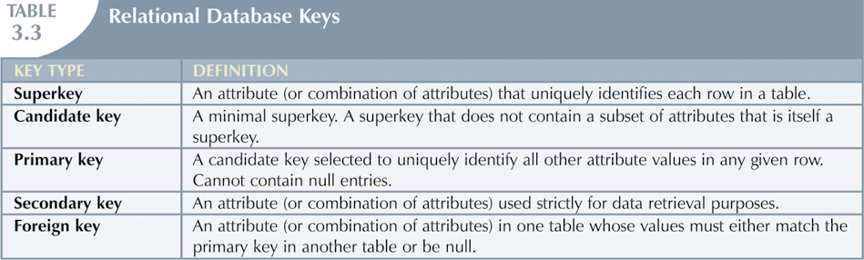
INTRODUCTION
Comparison
Jobs in Data Science
Relational Database
What is SQL ?
Keys (continued)

Slide 13
INTRODUCTION
Comparison
Jobs in Data Science
Relational Database
What is SQL ?
What is SQL?
SQL(Structured Query Language)is a standard language for accessing databases(DBMS -Database Management System)
SQL is a query language that allows user to specify the conditions(instead of algorithms). It is non-procedural language
A query is a user–request to retrieve data or information with a certain condition

Slide 14
INTRODUCTION
Comparison
Jobs in Data Science
Relational Database
What is SQL ?
SQL is relatively easy to learn
Basic command set has vocabulary of less than 100 words. The commands themselves are comprised of simple English words: select, from, where, update, etc
American National Standards Institute (ANSI) prescribes a standard SQL
Every database application is currently powered by SQLwith developers customizing the language to their own ends, however, and do not differ greatly from the ANSI standard

Slide 15
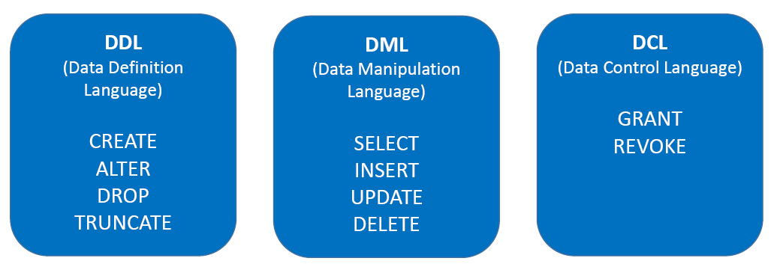
INTRODUCTION
Comparison
Jobs in Data Science
Relational Database
What is SQL ?
SQL Commands

Slide 16
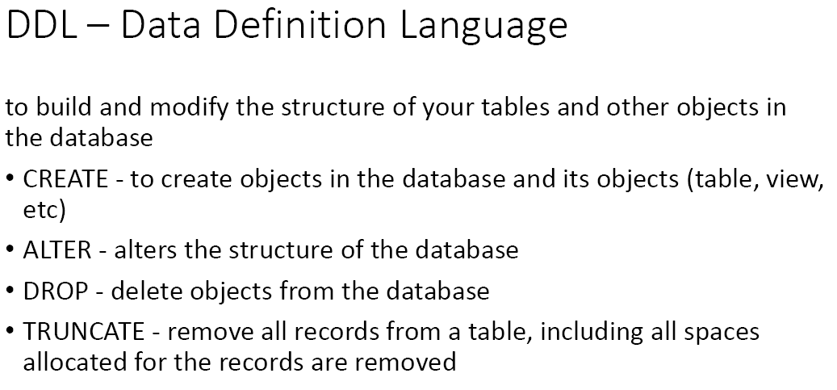
INTRODUCTION
Comparison
Jobs in Data Science
Relational Database
What is SQL ?
SQL Commands (Continued)

Slide 17
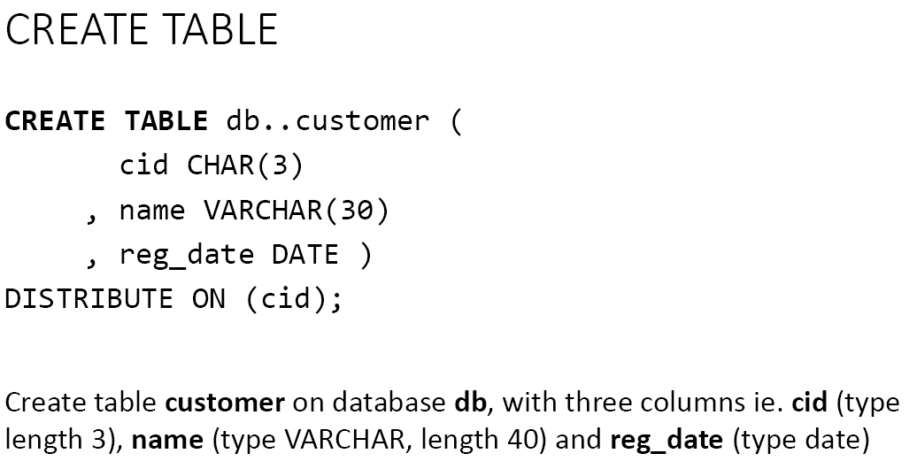
INTRODUCTION
Comparison
Jobs in Data Science
Relational Database
What is SQL ?
SQL Commands (Continued)

Slide 18
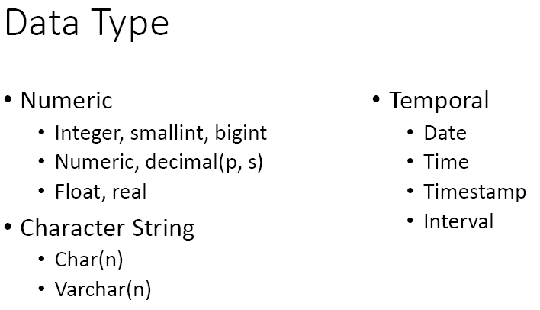
INTRODUCTION
Comparison
Jobs in Data Science
Relational Database
What is SQL ?
SQL Commands (Continued)

Slide 19
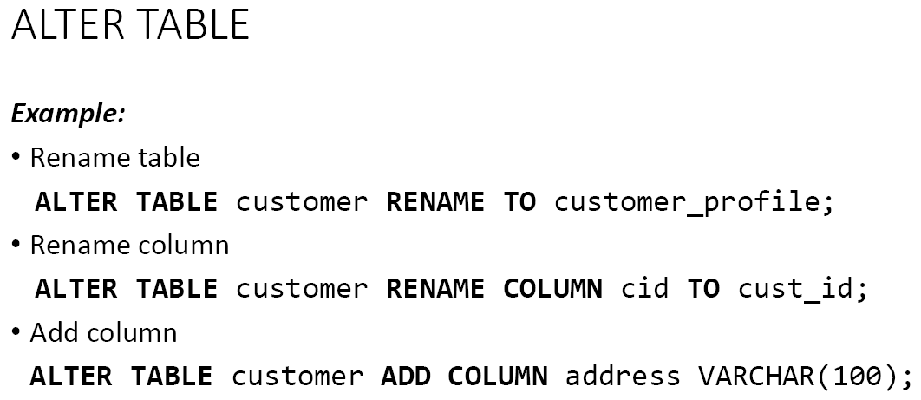
INTRODUCTION
Comparison
Jobs in Data Science
Relational Database
What is SQL ?
SQL Commands (Continued)

Slide 20
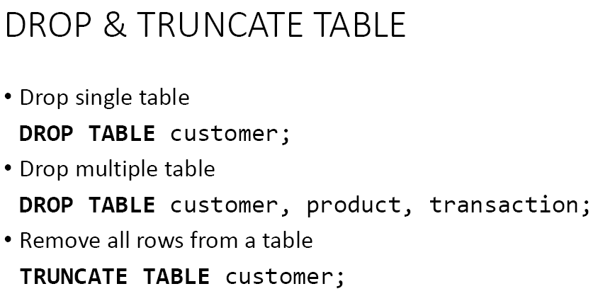
INTRODUCTION
Comparison
Jobs in Data Science
Relational Database
What is SQL ?
SQL Commands (Continued)

Slide 21
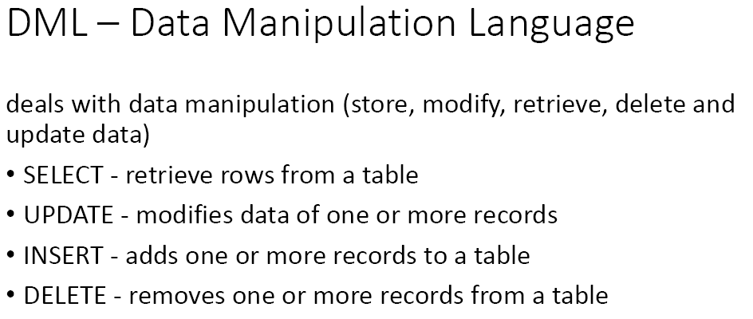
INTRODUCTION
Comparison
Jobs in Data Science
Relational Database
What is SQL ?
SQL Commands (Continued)

Slide 22
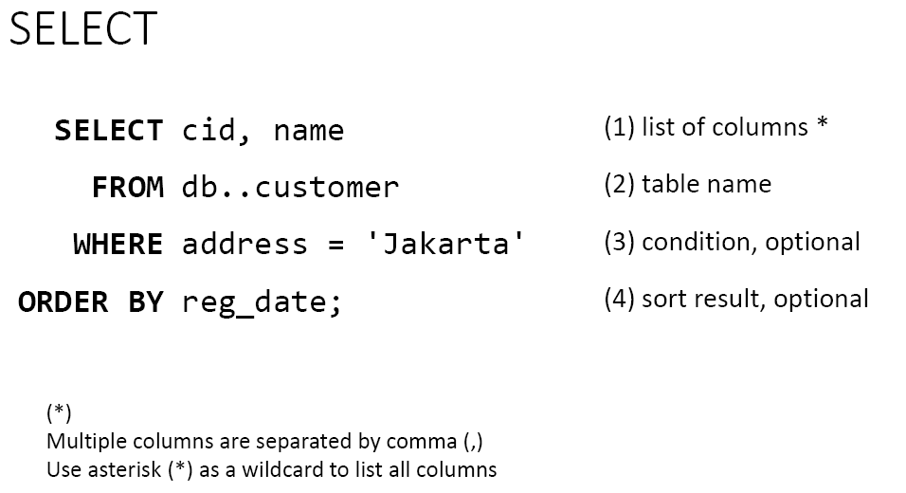
INTRODUCTION
Comparison
Jobs in Data Science
Relational Database
What is SQL ?
SQL Commands (Continued)

Slide 23
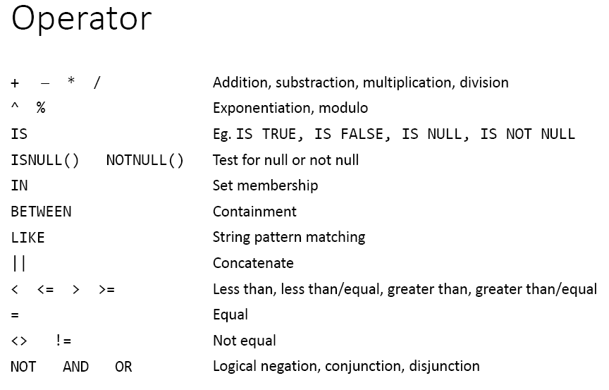
INTRODUCTION
Comparison
Jobs in Data Science
Relational Database
What is SQL ?
SQL Commands (Continued)

Slide 24
SQL BASIC

